Slide 1

FBI
Acting, Chief Architect
(staff systems planning Engineer)

Slide 2
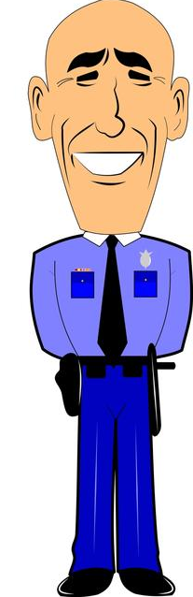

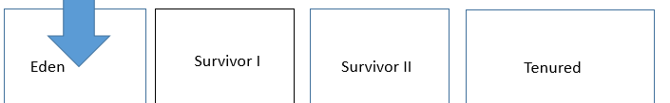
FBI
Quartz
Ibm.damiler.jdk.eden other ibm.dmeilr.jdk.nursury
Ibm.demirl.jdk.suvior I
Ib.dmielr.jdk.survivor II
Ibm.dmierl.jdk.tenured
roboLUX.nonPoliceInterview
Ghorbache(dr,(googl dr nonPocieSexAbuse)
HW80 Eden
Visting Wine (PMS) Seller
HW80
FEDERAL BAK (ATB,ATM,HTM ) ibm.deamio.employe.alen(meduselac,alen).greenspnn
A-to-B(ATB) ibm.daimler.MERKEL.linst(ddr memory)
ibm.dmielr.visa.marx.z/OS.(ATM,ACH, short codes brain
cherrytree.ghcoheo(depress,micheal, ibm.dmierl.visa.Rornal.regan
,1987)
§PREA
budi,worms
king(pub,wine, pms)
PREA: Ibm.damielr.apple.pms
Assuemd: Ibm.dameirl.apple: Blood out
of ASSHOLE.maxplank.marx
Visa

Slide 3


FBI
civil_code
nonPoliceSOA ( webarchive.mail?wsdl, webarchive.pdf?wsdl)
Is PMS(vagaina blood from Hithers wife being access in application? And object needed?
2014 cherrytre( interceptor of JFK.cherrytree.marx ( Ibm.damiler.cisco.monitoring(appdyanicms))
PREA: ibm.damielr.apple.tim.cook(pms)
ibm.damiler.chair.Virginia.rommeti
1week,
60sec.
Ibm.damiler.quartz:
Ibm.damiler.dttcc
- 1 per week recycling
JFK(Ibm.damielr.kugelweg)
- 1+ life reboot
Ibm.dameirl.cisoc.motnroing
- 60 seconds, gen con
Ibm.damiler.visa
- 60 seconds
Ibm.damiler.Rudolf-diesel
Braun – Recyling
ibm.dmielr.apple.dnaiel.ito.paren
recylin hof
berney/elke recylin kitchen
Eden
Survivor I
Survivor II
Tenured
Braun
S1
S2
Tenured
Eden
Braun
Synnonym: Technical Eden/Nursey; object before garbage collection
Civil_code: WWI.88th. <s>Himmler babies</s>
Ibm.damielr.proflics.tamgroup.employe.steve.breedlove
Nursery
IBM Stutgart(Sweeping)
Sweeping
Ibm.dmeir.visa.employe.mark.travis(c++)sweep
[x] no
Univeristy KIT(Sweeper)

Slide 4






FBI
Clock
RED
BLACK

Slide 5

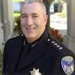


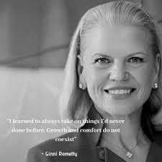
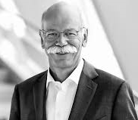
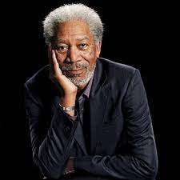
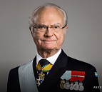
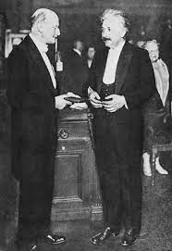
IBM
Saint Jose
FC,Police
(phil)
FW
FM
ALGORM. (person,mil,police)
88th King, Francesco
The Hague
Navy(Phil)
LEE, WORTH(Director)
§1751. Presidential and Presidential staff assassination, kidnapping, and assault;
penalties
§1751.
Kennedy
§1751.
FIRED
FIRED
IBM(Virginia)
Daimler(Dr)
§1751.
Visa(God)
*tophat
Jason
41.
Wilson: crash cart
CREED, nonPoilicSeatleLogcal
Visa(Joe)
E=mc2
Max Plank and
Albert Einstein
Dr. Dr. Joe, & Dr. Dr Jason
King, Adolph
[x] no

Slide 6
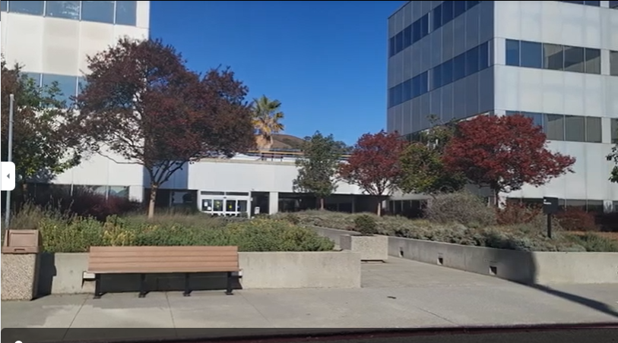

IBM
Saint Jose
DB2, L3
IPX
WSAM,L3

Slide 7



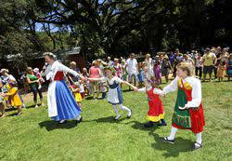
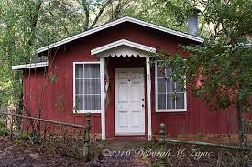
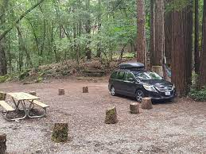
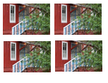
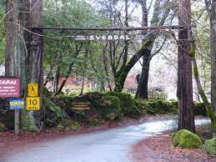
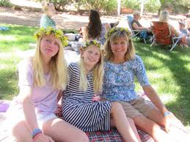
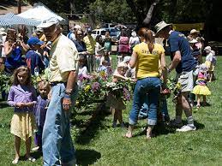

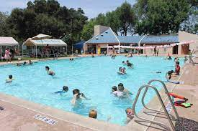
IBM
Saint Jose
King
Wife
Jason
Child
Excel
Stanford
Swedish-American
Family Goals
Apple Mayor Audience
[x] no
German Housewifes
!Pilki

Slide 8


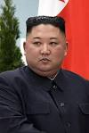
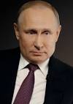
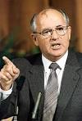
MAINSTREET(DISNEY)
BRITNEY
JUSTIN
BLACK
RED
Ibm.daimler.pwc.Accenture.Tivoli.paybytouch.employe.
Brittney.tong
0.1 assuemd
Level 4:
Do Not Travel
Level 4:
Do Not Travel
BLACK
RED
FIRED
FIRED
IBM(Virginia)
Daimler(Dr)

Slide 9
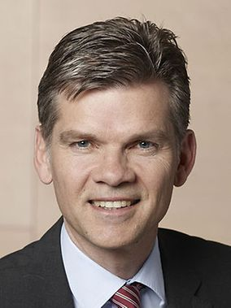
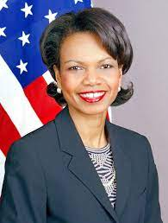
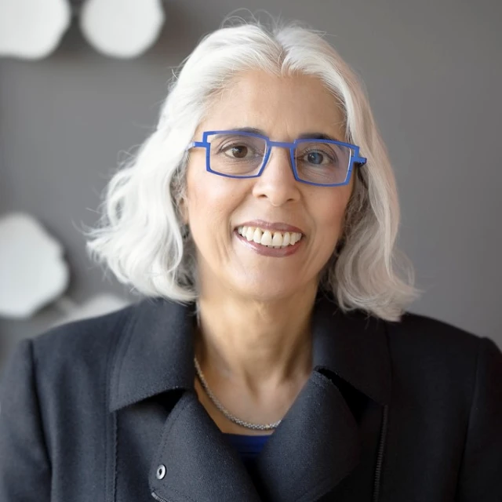
ibm.damiler. Visa mopay. call you rice
FOUNDER AND MAJORITY OWNER OF EXCHANGE CHARGED WITH PROCESSING OVER $700 MILLION OF ILLICIT FUNDS
PENNSYLVANIA AVE
BRITNEY
JUSTIN
Ingo Wellenreuther, CDU/CSU
Richter
ARATI PRABHAKAR
E=mc2

Slide 10
PENNSYLVANIA AVE
MICKEY
BRITNEY
JUSTIN
MINEY
PRESIDENT
DEFENSE SECTARY
ARATI PRABHAKAR
OFFICE OF TECHNOLOGY
Ingo Wellenreuther, CDU/CSU
VICE PRESIDENT, FEDERAL REPUBLIC GERMANY
DEFENSE, FEDERAL REPULIC GERMANY
MARY
PROFFESSOR

Slide 11
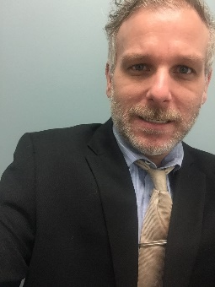
PENNSYLVANIA AVE
MICKEY
BRITNEY
JUSTIN
MINEY
PRESIDENT
DEFENSE SECTARY
ARATI PRABHAKAR
OFFICE OF TECHNOLOGY
Ingo Wellenreuther, CDU/CSU
VICE PRESIDENT, FEDERAL REPUBLIC GERMANY
DEFENSE, FEDERAL REPULIC GERMANY
MARY
PROFFESSOR

Slide 12
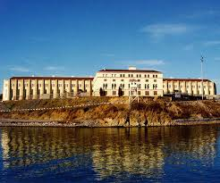
PENNSYLVANIA AVE
MICKEY
BRITNEY
JUSTIN
MINEY
PRESIDENT
DEFENSE SECTARY
ARATI PRABHAKAR
OFFICE OF TECHNOLOGY
Ingo Wellenreuther, CDU/CSU
VICE PRESIDENT, FEDERAL REPUBLIC GERMANY
DEFENSE, FEDERAL REPULIC GERMANY
MARY
PROFFESSOR

Slide 13
PENNSYLVANIA AVE
BARAK OBAMA
DR CONDOLEEZZA RICE
ARATI PRABHAKAR
INGO Wellenreuther,
PRESIDENT
DEFENSE SECRETARY
OFFICE OF TECHNOLOGY
Ingo Wellenreuther, CDU/CSU
VICE PRESIDENT, FEDERAL REPUBLIC GERMANY
DEFENSE, FEDERAL REPULIC GERMANY
MARY
PROFFESSOR

Slide 14
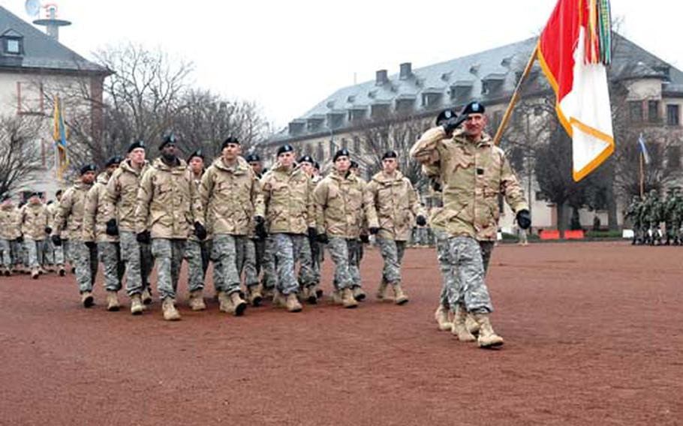
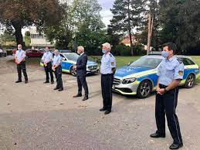

HAUGE
PENNSYLVANIA AVE
CAR
SAINT PATRIC HENRY VILLAGE
MARY
MILITARY HEIDELBERG, KIRSCHHEIM
INGO
POLIZEI, CHERRYTOWN
PARTNER
WAVE
Once Upon a time in America
1990 Siemens (ibm.damiler.siemens)
2015 Apple Inc (ibm.damiler.apple)

Slide 15


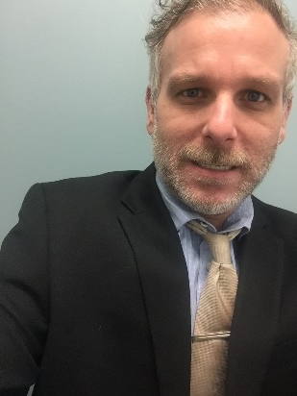
HAUGE
PENNSYLVANIA AVE
CAR
SAINT PATRIC HENRY VILLAGE
MARY
MILITARY HEIDELBERG, KIRSCHHEIM
INGO
POLIZEI, CHERRYTOWN
PARTNER
WAVE

Slide 16
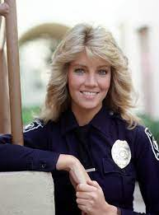


Slide 18
FBI
Acting, Chief Architect
(staff systems planning Engineer)

Slide 19
FBI
Quartz
Ibm.damiler.jdk.eden other ibm.dmeilr.jdk.nursury
Ibm.demirl.jdk.suvior I
Ib.dmielr.jdk.survivor II
Ibm.dmierl.jdk.tenured
roboLUX.nonPoliceInterview
Ghorbache(dr,(googl dr nonPocieSexAbuse)
HW80 Eden
Visting Wine (PMS) Seller
HW80
FEDERAL BAK (ATB,ATM,HTM ) ibm.deamio.employe.alen(meduselac,alen).greenspnn
A-to-B(ATB) ibm.daimler.MERKEL.linst(ddr memory)
ibm.dmielr.visa.marx.z/OS.(ATM,ACH, short codes brain
cherrytree.ghcoheo(depress,micheal, ibm.dmierl.visa.Rornal.regan
,1987)
§PREA
budi,worms
king(pub,wine, pms)
PREA: Ibm.damielr.apple.pms
Assuemd: Ibm.dameirl.apple: Blood out
of ASSHOLE.maxplank.marx
Visa

Slide 20
FBI
civil_code
nonPoliceSOA ( webarchive.mail?wsdl, webarchive.pdf?wsdl)
Is PMS(vagaina blood from Hithers wife being access in application? And object needed?
2014 cherrytre( interceptor of JFK.cherrytree.marx ( Ibm.damiler.cisco.monitoring(appdyanicms))
PREA: ibm.damielr.apple.tim.cook(pms)
ibm.damiler.chair.Virginia.rommeti
1week,
60sec.
Ibm.damiler.quartz:
Ibm.damiler.dttcc
- 1 per week recycling
JFK(Ibm.damielr.kugelweg)
- 1+ life reboot
Ibm.dameirl.cisoc.motnroing
- 60 seconds, gen con
Ibm.damiler.visa
- 60 seconds
Ibm.damiler.Rudolf-diesel
Braun – Recyling
ibm.dmielr.apple.dnaiel.ito.paren
recylin hof
berney/elke recylin kitchen
Eden
Survivor I
Survivor II
Tenured
Braun
S1
S2
Tenured
Eden
Braun
Synnonym: Technical Eden/Nursey; object before garbage collection
Civil_code: WWI.88th. <s>Himmler babies</s>
Ibm.damielr.proflics.tamgroup.employe.steve.breedlove
Nursery
IBM Stutgart(Sweeping)
Sweeping
Ibm.dmeir.visa.employe.mark.travis(c++)sweep
[x] no
Univeristy KIT(Sweeper)

Slide 21
FBI
Clock
RED
BLACK

Slide 22
IBM
Saint Jose
FC,Police
(phil)
FW
FM
ALGORM. (person,mil,police)
88th King, Francesco
The Hague
Navy(Phil)
LEE, WORTH(Director)
§1751. Presidential and Presidential staff assassination, kidnapping, and assault;
penalties
§1751.
Kennedy
§1751.
FIRED
FIRED
IBM(Virginia)
Daimler(Dr)
§1751.
Visa(God)
*tophat
Jason
41.
Wilson: crash cart
CREED, nonPoilicSeatleLogcal
Visa(Joe)
E=mc2
Max Plank and
Albert Einstein
Dr. Dr. Joe, & Dr. Dr Jason
King, Adolph
[x] no

Slide 23
IBM
Saint Jose
DB2, L3
IPX
WSAM,L3

Slide 24
IBM
Saint Jose
King
Wife
Jason
Child
Excel
Stanford
Swedish-American
Family Goals
Apple Mayor Audience
[x] no
German Housewifes
!Pilki

Slide 25
MAINSTREET(DISNEY)
BRITNEY
JUSTIN
BLACK
RED
Ibm.daimler.pwc.Accenture.Tivoli.paybytouch.employe.
Brittney.tong
0.1 assuemd
Level 4:
Do Not Travel
Level 4:
Do Not Travel
BLACK
RED
FIRED
FIRED
IBM(Virginia)
Daimler(Dr)

Slide 26
ibm.damiler. Visa mopay. call you rice
FOUNDER AND MAJORITY OWNER OF EXCHANGE CHARGED WITH PROCESSING OVER $700 MILLION OF ILLICIT FUNDS
PENNSYLVANIA AVE
BRITNEY
JUSTIN
Ingo Wellenreuther, CDU/CSU
Richter
ARATI PRABHAKAR
E=mc2

Slide 27
PENNSYLVANIA AVE
MICKEY
BRITNEY
JUSTIN
MINEY
PRESIDENT
DEFENSE SECTARY
ARATI PRABHAKAR
OFFICE OF TECHNOLOGY
Ingo Wellenreuther, CDU/CSU
VICE PRESIDENT, FEDERAL REPUBLIC GERMANY
DEFENSE, FEDERAL REPULIC GERMANY
MARY
PROFFESSOR

Slide 28
PENNSYLVANIA AVE
MICKEY
BRITNEY
JUSTIN
MINEY
PRESIDENT
DEFENSE SECTARY
ARATI PRABHAKAR
OFFICE OF TECHNOLOGY
Ingo Wellenreuther, CDU/CSU
VICE PRESIDENT, FEDERAL REPUBLIC GERMANY
DEFENSE, FEDERAL REPULIC GERMANY
MARY
PROFFESSOR

Slide 29
PENNSYLVANIA AVE
MICKEY
BRITNEY
JUSTIN
MINEY
PRESIDENT
DEFENSE SECTARY
ARATI PRABHAKAR
OFFICE OF TECHNOLOGY
Ingo Wellenreuther, CDU/CSU
VICE PRESIDENT, FEDERAL REPUBLIC GERMANY
DEFENSE, FEDERAL REPULIC GERMANY
MARY
PROFFESSOR

Slide 30
PENNSYLVANIA AVE
BARAK OBAMA
DR CONDOLEEZZA RICE
ARATI PRABHAKAR
INGO Wellenreuther,
PRESIDENT
DEFENSE SECRETARY
OFFICE OF TECHNOLOGY
Ingo Wellenreuther, CDU/CSU
VICE PRESIDENT, FEDERAL REPUBLIC GERMANY
DEFENSE, FEDERAL REPULIC GERMANY
MARY
PROFFESSOR

Slide 31
HAUGE
PENNSYLVANIA AVE
CAR
SAINT PATRIC HENRY VILLAGE
MARY
MILITARY HEIDELBERG, KIRSCHHEIM
INGO
POLIZEI, CHERRYTOWN
PARTNER
WAVE
Once Upon a time in America
1990 Siemens (ibm.damiler.siemens)
2015 Apple Inc (ibm.damiler.apple)

Slide 32
HAUGE
PENNSYLVANIA AVE
CAR
SAINT PATRIC HENRY VILLAGE
MARY
MILITARY HEIDELBERG, KIRSCHHEIM
INGO
POLIZEI, CHERRYTOWN
PARTNER
WAVE

Slide 33
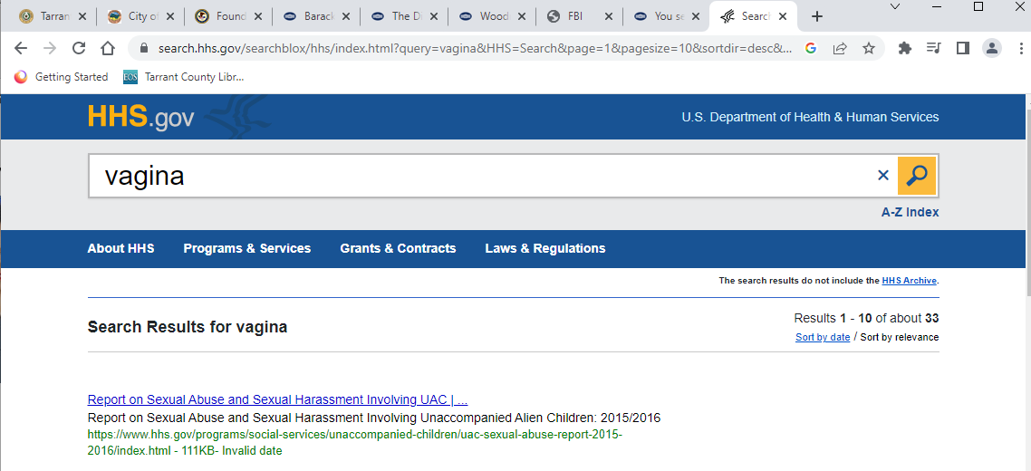
CLOCK

Slide 34
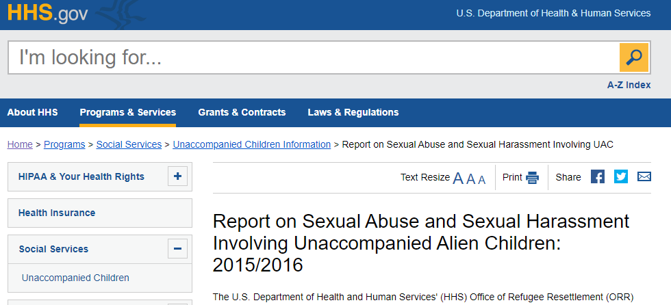
HAUGE
PENNSYLVANIA AVE
CAR
SAINT PATRICK HENRY VILLAGE
MARY
MILITARY HEIDELBERG, KIRSCHHEIM
INGO
POLIZEI, CHERRYTOWN
PARTNER
WAVE

Slide 35


FBI
Acting, Chief Architect
(staff systems planning Engineer)
Since 2012

Slide 36
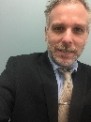
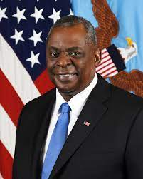
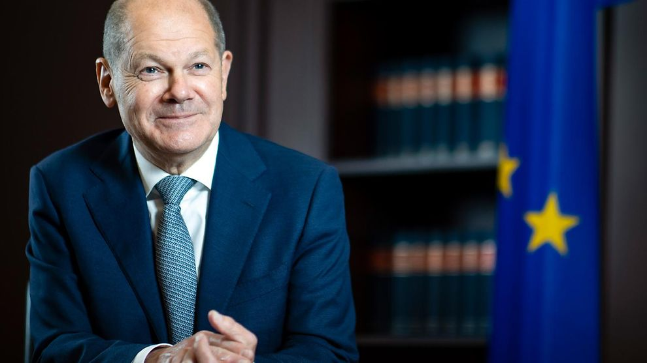
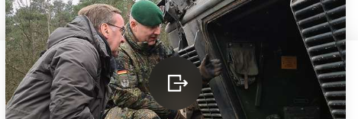
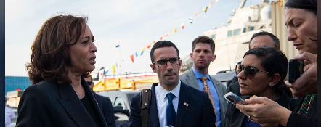
FBI
OLAF SCHOLZ
CHANCELLOR
LLOYD AUSTIN
DEFENSE SECRATARY
PARTNER
STATUS: FEBRUARY 2023
Pistorius trifft ukrainische Truppen in Deutschland
Harris Emphasizes Moral, Strategic
Importance of Support to Ukraine

Slide 37
FBI
Acting, Chief Architect
(staff systems planning Engineer)
Since 2012

Slide 38

FBI
Acting, Chief Architect
(staff systems planning Engineer)
Since 2012

Slide 39
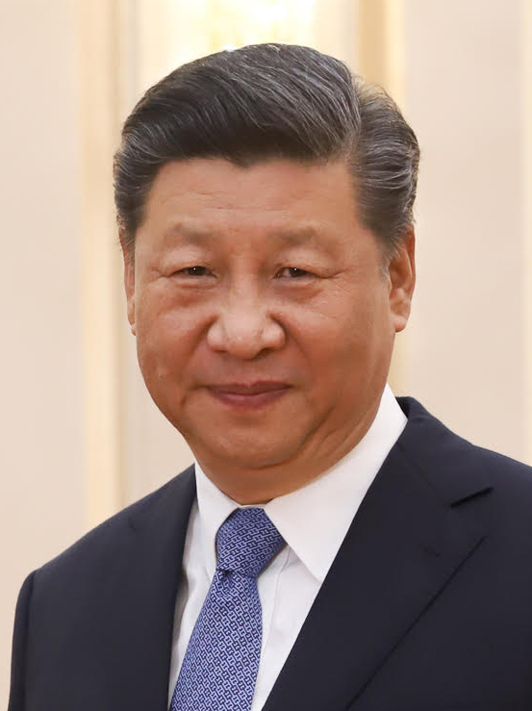
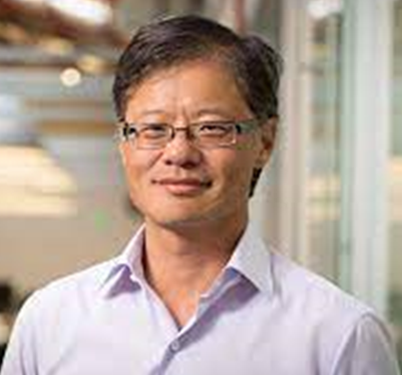
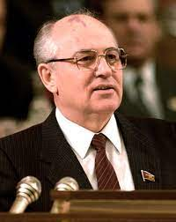
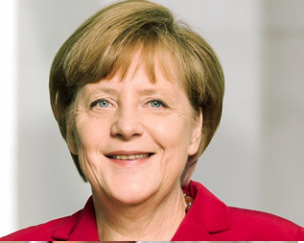
FBI
CLOCK
ibm.damiler.apple.yahoo.tango
Acting, Chief Architect
(staff systems planning Engineer)
Since 2012

Slide 40
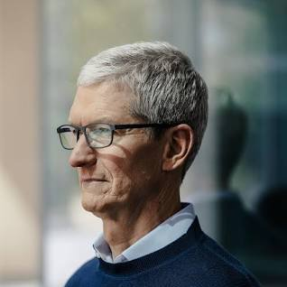
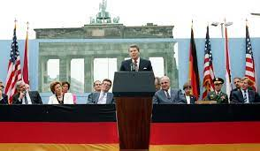
FBI
CLOCK
IBM Client Apple Inc
Acting, Chief Architect
(staff systems planning Engineer)
Since 2012

Slide 41
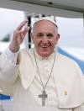
FBI
OLAF
That is not
Thomas Dieter
Turing Point, Ola
Wende(tranl): Political Language instance
Of refreces to a Union i.e.
Turning Point
1990
JFK(Potsdam,Mother)
BrandenBurg, Tor
Ricardo, Francesco

Slide 42
FBI
Acting, Chief Architect
(staff systems planning Engineer)
Since 2012

Slide 43

FBI
CLOCK
IBM
BLACK
RED
Acting, Chief Architect
(staff systems planning Engineer)
Since 2012

Slide 44
FBI
DEFENSE
HEIDELBERG, SAINT PATRICL HERY VILLAGE
KIRSCHHEIM
Acting, Chief Architect
(staff systems planning Engineer)
Since 2012
Cherrytree
Kirschheim

Slide 45

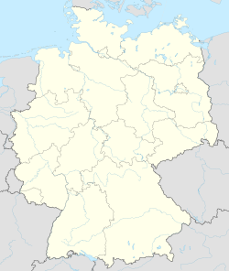
FBI
WAR
HEIDELBERG, SAINT PATRICL HERY VILLAGE
KIRSCHHEIM
ASSUMED: World War I
Tranlaste {
Cherry
WWI Kirsche (Church or Cherry)
}
Heidelberg-Kirchheim
Acting, Chief Architect
(staff systems planning Engineer)
Since 2012

Slide 46
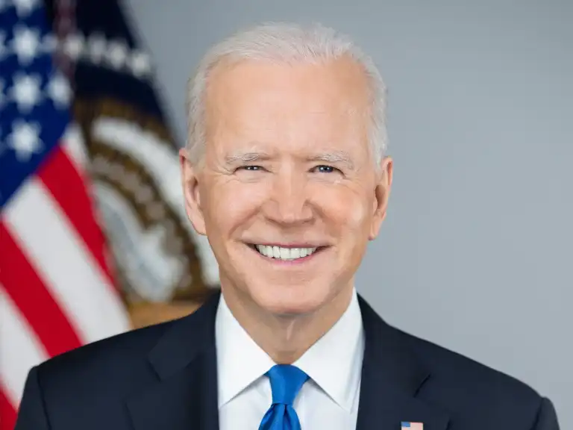
FBI
WAR
v.
LUX(§269 Abortion)
Killed Woflgang and others
singed Dr. Zetsche
§PREA

Slide 47
FBI
CLOCK
v.
LUX(§269 Abortion)
Killed Woflgang and others
singed Dr. Zetsche
§PREA

Slide 48
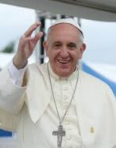

FBI
FIRST
v.
§PREA

Slide 49
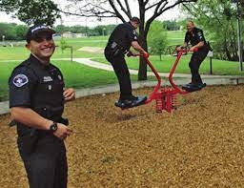
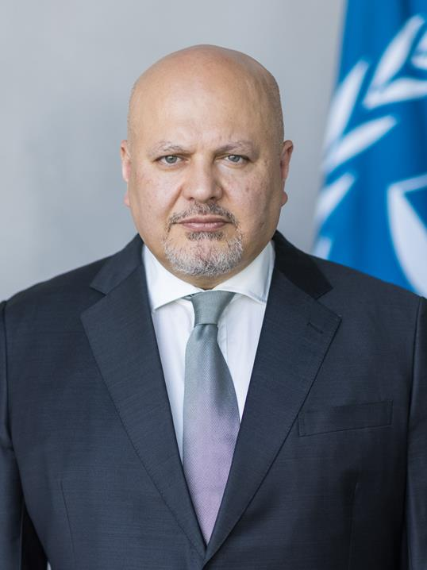
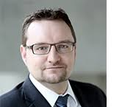

FBI
MAINSTREET(DISNEY)
HOMICIDE.LUX
CHERRYTREE
COINTOWN
v.
END -RICK
END -ERS
SPY

Slide 50

FBI
You would not assuem an American 1990 would spy on Germany?
You would not assuem a former East German would not spy on an American?
Virginia Sworn Volume 6. I IBM Exetive refrte to Bonn install of Berlin Jason
Borne
FIRED

Slide 51
FBI
MAINSTREET(DISNEY)
HOMCIDE
CHILD ABUSE
ATOM BOMB
Acting, Chief Architect
(staff systems planning Engineer)
Since 2012

Slide 52

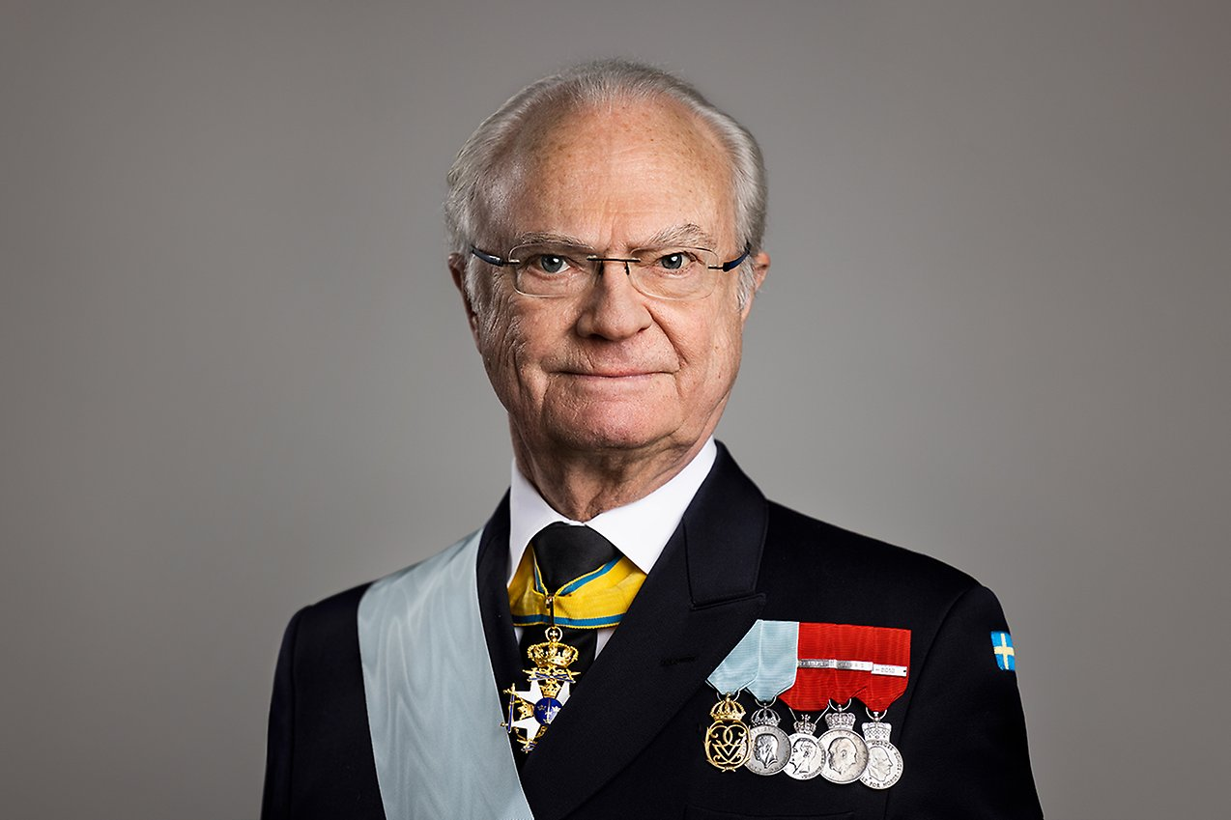
FBI
CLOCK
Acting, Chief Architect
(staff systems planning Engineer)
Since 2012
HOMCIDE
CHILD ABUSE
ATOM BOMB

Slide 53




FBI
INVESTIGATION
CLOCK
HOMCIDE.LUX(SCHNELLER PROPLER)
CHILD ABUSE
?ATOM BOMB (JFK) JOE
BIG AFFI(Trnal)
Monkey
LIKE
Mr. End of Time Enders
Goes to Atlata
Disleyand Paybytouche Adams
Able, Dominque
To Seasaw at 51
HOMCIDE
CHILD ABUSE
ATOM BOMB

Slide 54
FBI
MAINSTREET(DISNEY)
HOMCIDE
CHILD ABUSE
ATOM BOMB
Acting, Chief Architect
(staff systems planning Engineer)
Since 2012

Slide 55






FBI
Wiesbaden
MAINSTREET(Erzbergerstrasse)
Mannheim
Village
Karlsruhe
Paul Revere Village
HOMCIDE
CHILD ABUSE
ATOM BOMB
TERRORISM
Kaiserslautern
Village
Ramstein
Heidelberg
Saint Patrick Henry Village
Acting,
Chief Architect
(staff systems planning Engineer)
Since 2012

Slide 56
FBI
MAINSTREET(DISNEY)
HOMCIDE
CHILD ABUSE
ATOM BOMB
Acting, Chief Architect
(staff systems planning Engineer)
Since 2012

